Slide 1

Soil Organic carbon PREDICTION in DHANAULTI REGION Using ML Approach
Indian Institute of Remote Sensing(IIRS) Dehradun
Submitted by:
Jasmin babariya – 202219014
Harsh Velani - 202319025
UNDER THE GUIDENCE OF
Mr. Justin George K.

Slide 2
CONTENTS
Introduction
What is Soil Organic Carbon?
Benefits of SOC Mapping
Machine Learning Approach
Materials \ Features
About Data
Layout of input variable
Flowchart
Flowchart of methodology for ML
Soil Organic Carbon Predicted Map
Soil Organic Carbon Uncertainty Map
Result
Conclusion

Slide 3
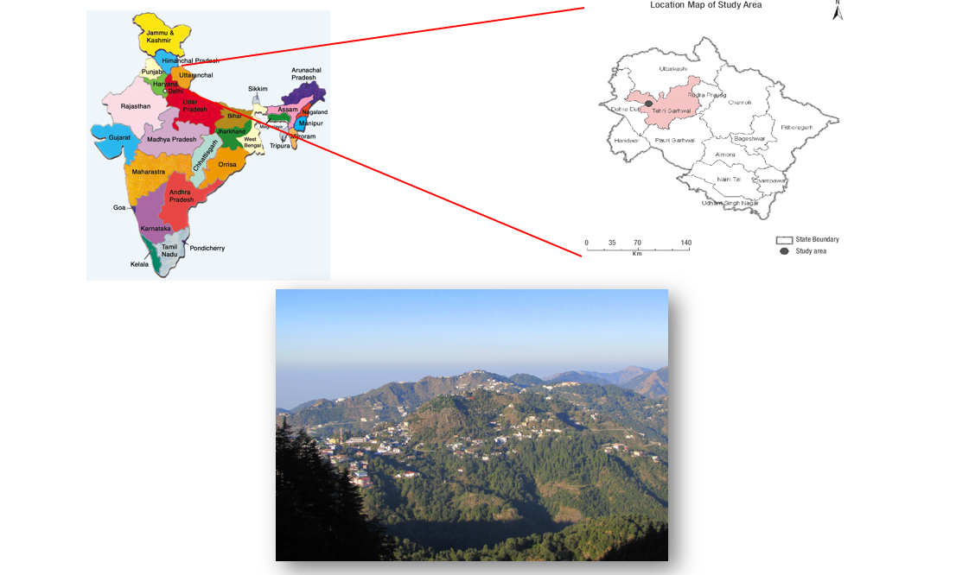
INTRODUCTION
The study area selected was dhanaulti. Dhanaulti is a small town located in the Uttarakhand state of India, nestled in the Garhwal Himalayas. It is situated at an elevation of approximately 2,250 meters above sea level. Dhanaulti located in the Garhwal Hills between 30′ 45° N and 78′ 25° E
The Himalayan region is known for its diverse ecosystems and rich biodiversity. However, the rapid changes in land use patterns, climate change, and human interference have led to a decline in soil organic carbon (SOC) levels in the region.
To address this issue, machine learning (ML) is being used to map SOC in the Himalayan watershed. This approach can help identify areas that are most vulnerable to soil degradation and prioritize conservation efforts.

Slide 4
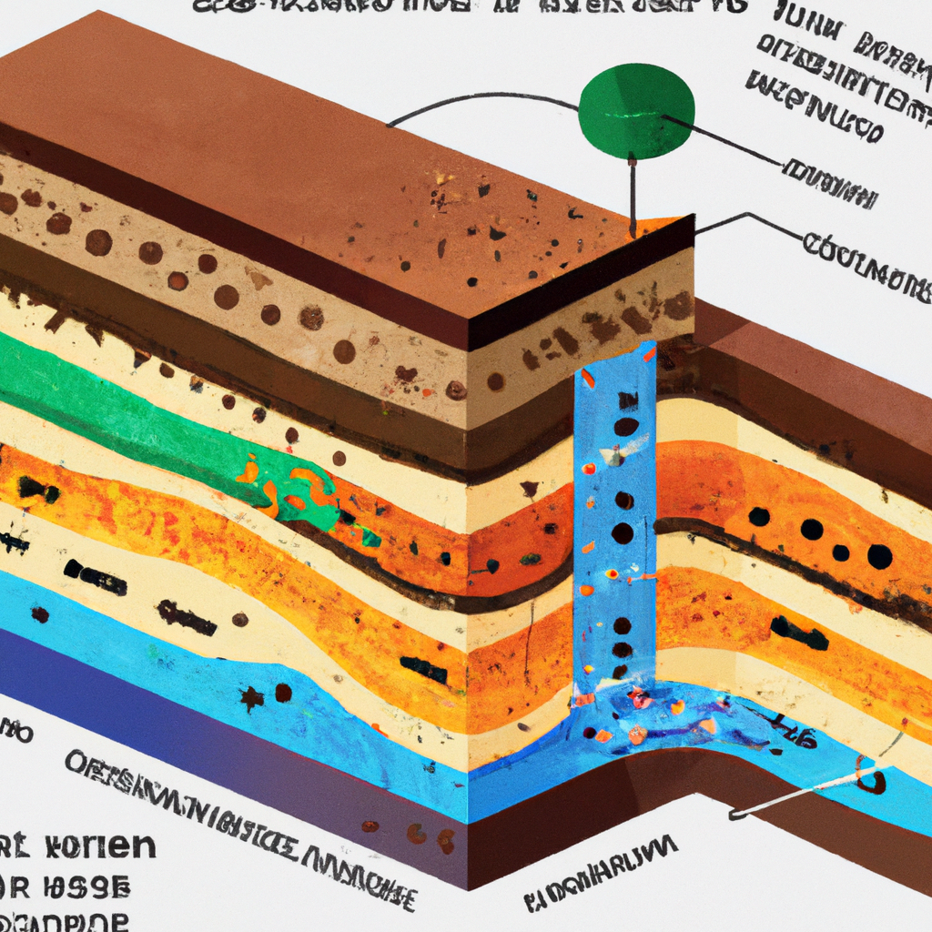
WHAT IS SOIL ORGANIC CARBON?
Soil organic carbon (SOC) is the carbon stored in the soil as a result of plant and animal decomposition. It is a critical component of soil health, as it helps improve soil structure and fertility.
SOC levels are influenced by various factors, including climate, topography, vegetation cover, and land use patterns. In the Himalayan region, high-altitude and steep slopes make it challenging to maintain SOC levels, leading to soil erosion and degradation.

Slide 5
BENEFITS OF SOC MAPPING
Mapping SOC levels in the Dhanaulti Region can provide valuable insights into the health of the region's soil and identify areas that are most vulnerable to degradation.
This information can be used to prioritize conservation efforts, develop sustainable land use practices, and mitigate the effects of climate change.
Additionally, SOC mapping can help policymakers make informed decisions about resource allocation and management in the region.

Slide 6
MACHINE LEARNING APPROACH
Machine learning (ML) is a data-driven approach that uses algorithms to learn from data and make predictions. Machine learning (ML)is used to map SOC levels in the Himalayan watershed by analyzing various factors that influence SOC levels.
In this project, Quantile Regression Forest Model of machine learning is used.
Quantile Regression Forest is a statistical and machine learning technique that combines the concepts of quantile regression and random forests. It is used to model the conditional distribution of a response variable, given a set of predictor variables, by estimating quantiles at different levels, rather than just predicting the mean as in traditional regression.

Slide 7
Materials \ Features
Independent Variables / Features:
Normalized Difference Vegetation Index (NDVI) - Sentinel 2
Digital Elevation Model (DEM) - Sentinel 2
Land Use Land Cover (LULC) – Google/Dynamic WORLD
Lithology - BHUKOSH
Slope
Aspect
Topographic Wetness Index (TWI)
Flow Accumulation
Dependent Variable / Target:
Total Organic Carbon (%)
GEE Code

Slide 8
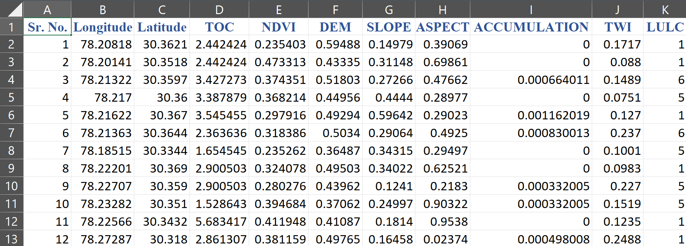
About Data
Data contains 80 rows and 10 columns.
Data having 8 features as input and Total Organic Carbon as output.

Slide 9
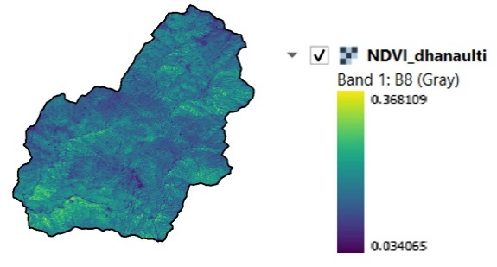
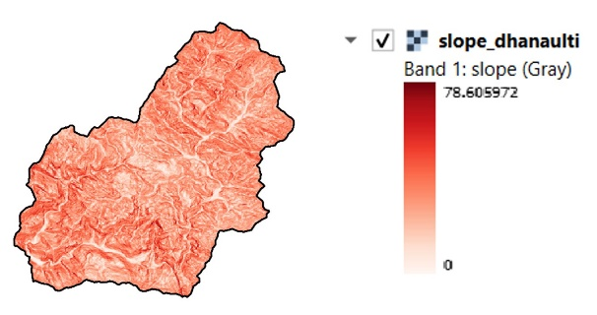
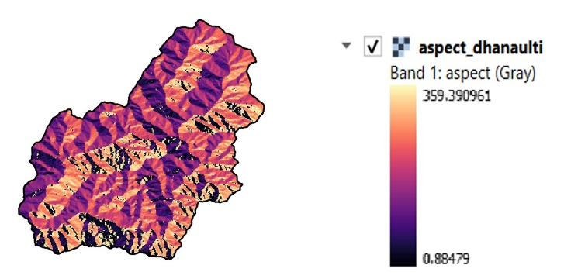
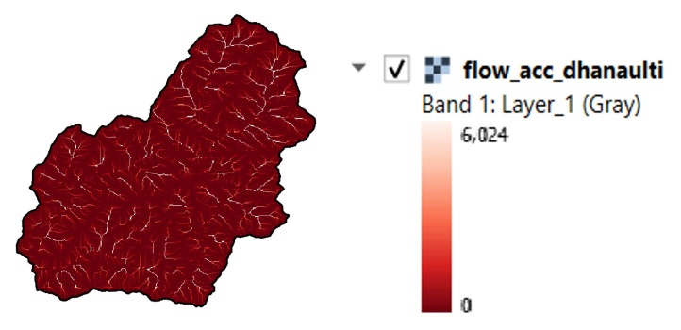
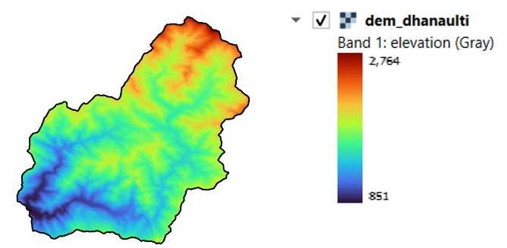
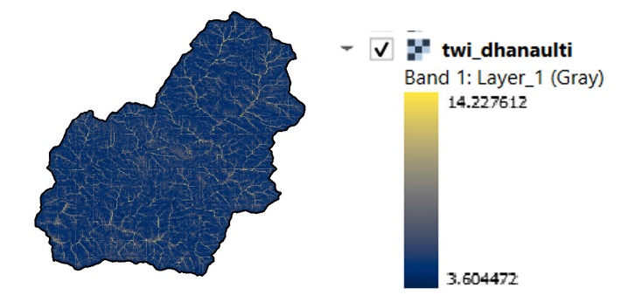
Layout of Input Variable

Slide 10
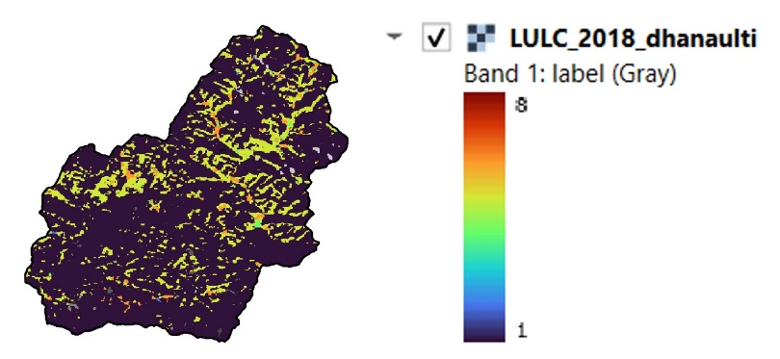
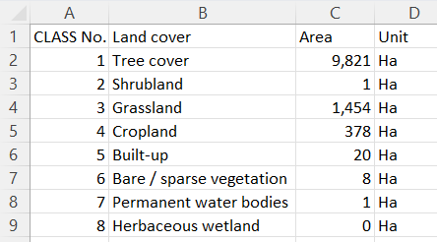
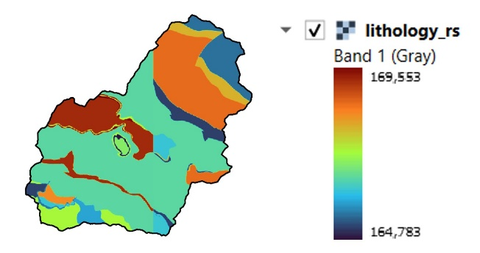
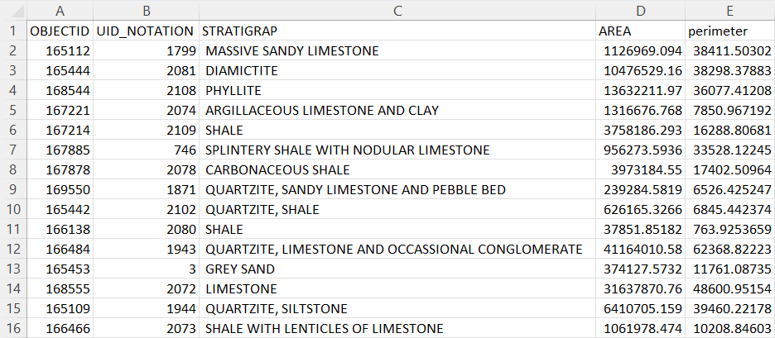

Slide 11
Flowchart
Download Images
By using GEE
Map Generation
Machine Learning
Algorithm
(Quantile Regression forest)
Normalized Images
Data CSV
Sample Raster
Stack Images

Slide 12
Flowchart of methodology for ML
Soil Data
Model validation through test data
Selection of ml algorithm
Model evaluation
Splitting of data
prediction
Training data
Testing data
70%
30%
Apply ml algorithm

Slide 13
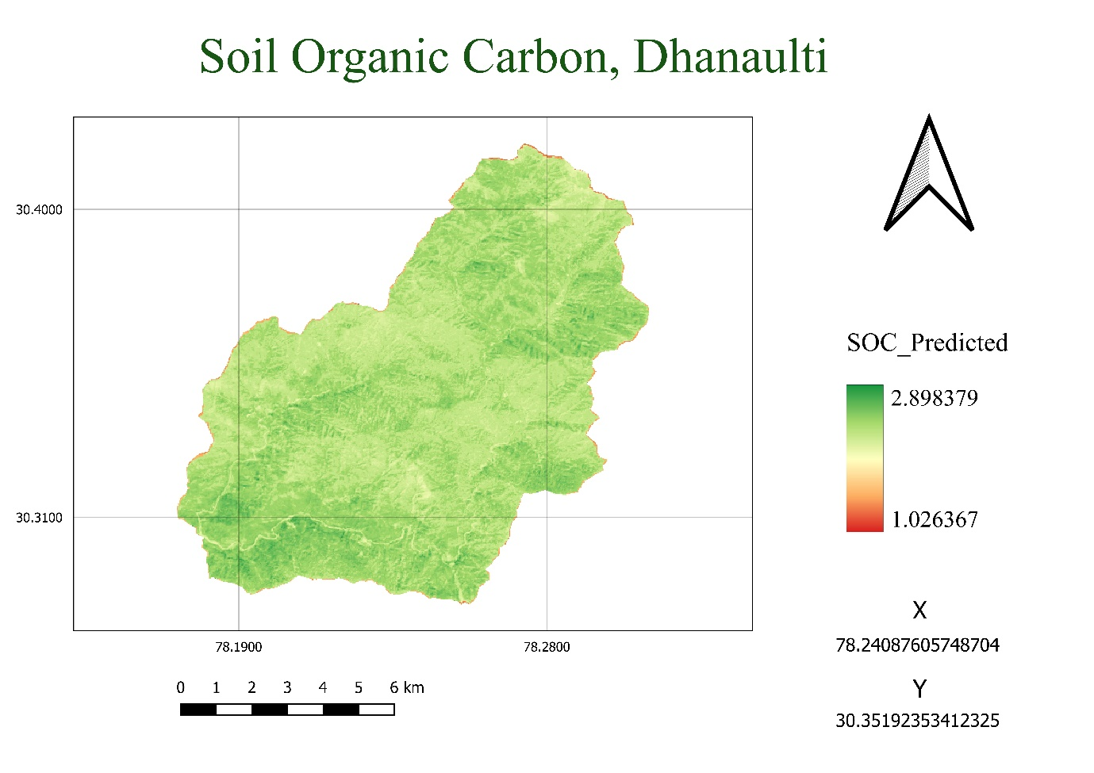
SOC predicted map

Slide 14
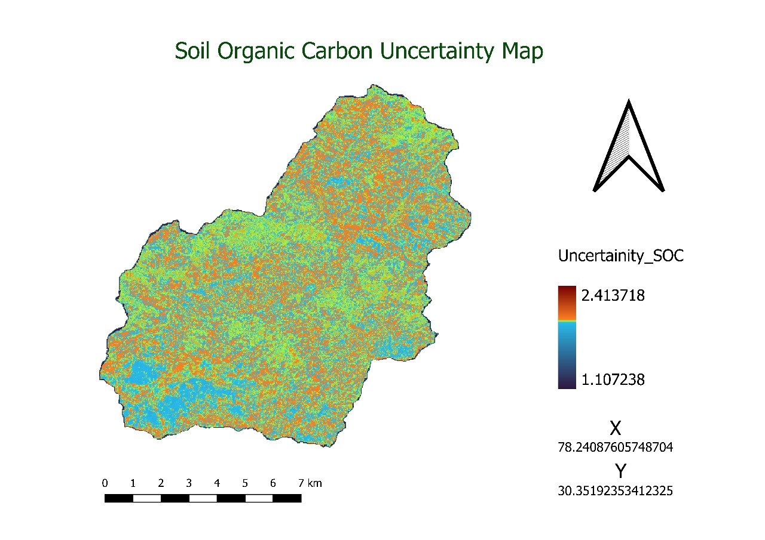
Uncertainty map

Slide 15
Result
Sr. No. | MAE | RMSE | Coverage probability | ALPHA
1 | 1.301863 | 0.186702 | 37.5% | 0.95

Slide 16
CONCLUSION
In conclusion, the use of quantile regression forest for soil organic carbon prediction has shown promise in overcoming challenges associated with conditional standard deviation, heteroscedasticity, missing data, and outliers. It has the potential to improve our understanding of SOC dynamics, uncover complex relationships with other environmental variables.
The Quantile regression forest (QRF) model is a powerful tool for generating uncertainty maps in various applications. QRF can help decision-makers better understand the reliability of predictions, identify areas of high uncertainty, and make informed decisions based on risk assessment.

Slide 17
THANK YOU

